Slide 1
Chapter 10:
Computer Graphics
Computer Science: An Overview
Eleventh Edition
by
J. Glenn Brookshear

Slide 2
Chapter 10: Computer Graphics
10.1 The Scope of Computer Graphics
10.2 Overview of 3D Graphics
10.3 Modeling
10.4 Rendering
10.5 Dealing with Global Lighting
10.6 Animation
0-<number>

Slide 3
2D Versus 3D Graphics
2D Graphics: Deals with manipulating two-dimensional images
3D Graphics: Deals with producing and displaying images of three-dimensional virtual scenes.
0-<number>

Slide 4
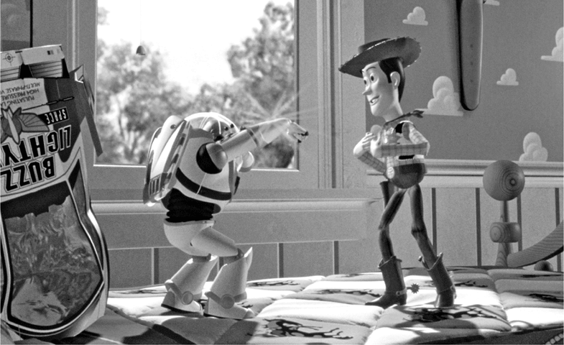
Figure 10.1 A “photograph” of a virtual world produced using 3D graphics (from Toy Story by Walt Disney Pictures/Pixar Animation Studios) © Corbis/Sygma
0-<number>

Slide 5
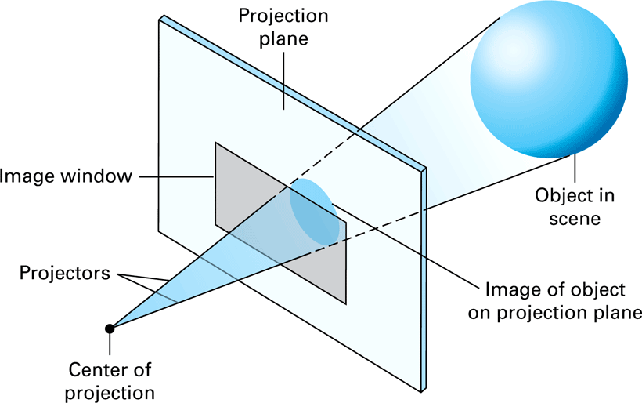
Figure 10.2 The 3D graphics paradigm
0-<number>

Slide 6
Modeling Objects
Shape: Represented by a polygonal mesh obtained from
  Traditional mathematical equations
  Berzier curves and surfaces
  Procedural models
  Other methods being researched
Surface: Can be represented by a texture map
0-<number>

Slide 7
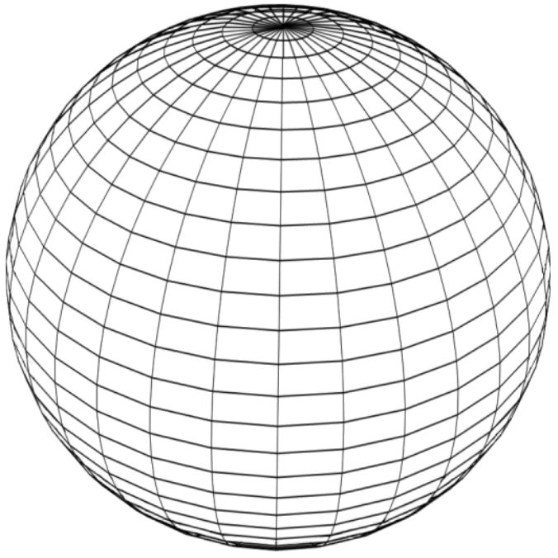
Figure 10.3 A polygonal mesh for a sphere
0-<number>

Slide 8
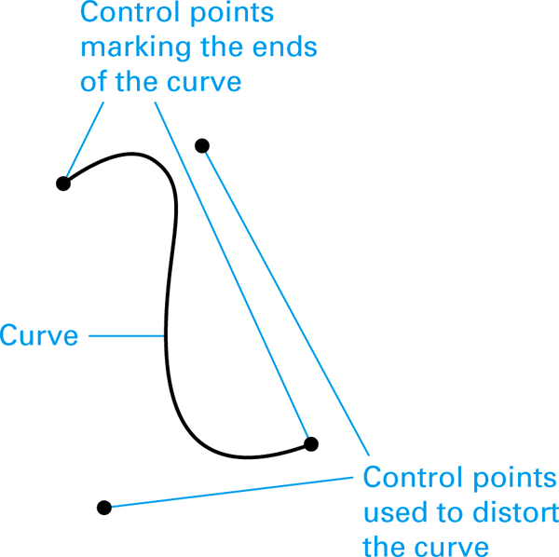
Figure 10.4 A Bezier curve
0-<number>

Slide 9
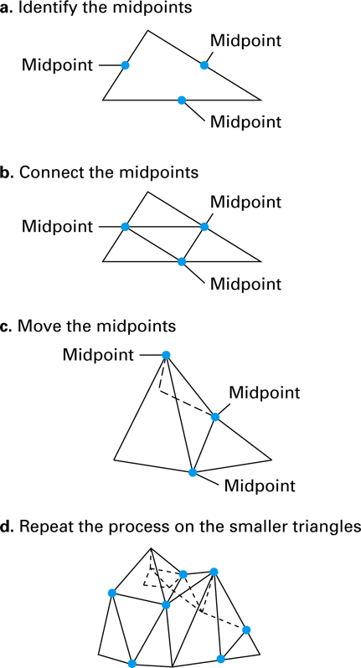
Figure 10.5 Growing a polygonal mesh for a mountain range
0-<number>

Slide 10
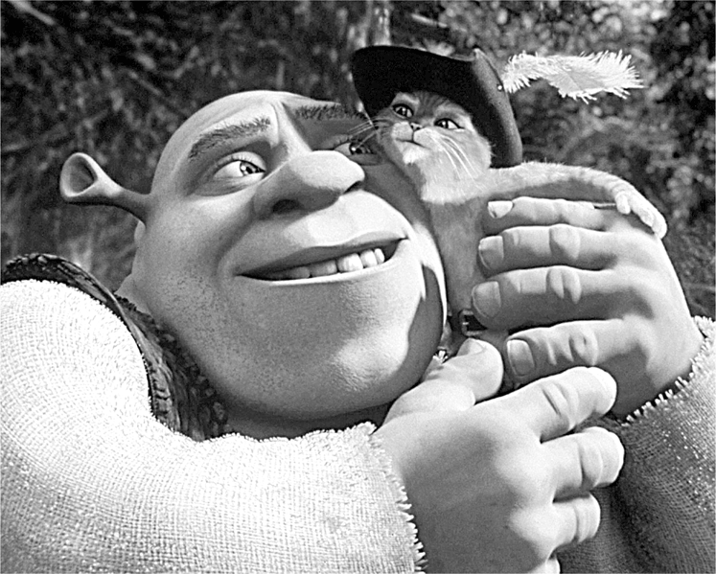
Figure 10.6 A scene from Shrek 2 by Dreamworks SKG (© Dreamworks/The Kobal Collection)
0-<number>

Slide 11
Reflection Versus Refraction
Reflection: Light rays bounce off surface.
  Specular light
  Diffuse light
  Ambient light
Refraction: Light rays penetrate surface.
0-<number>

Slide 12
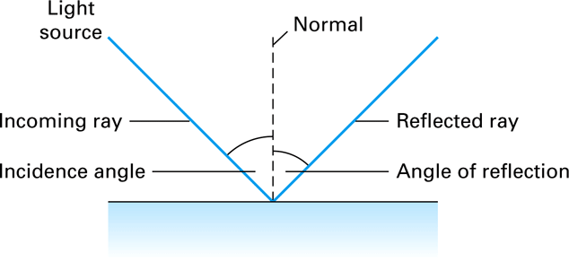
Figure 10.7 Reflected light
0-<number>

Slide 13
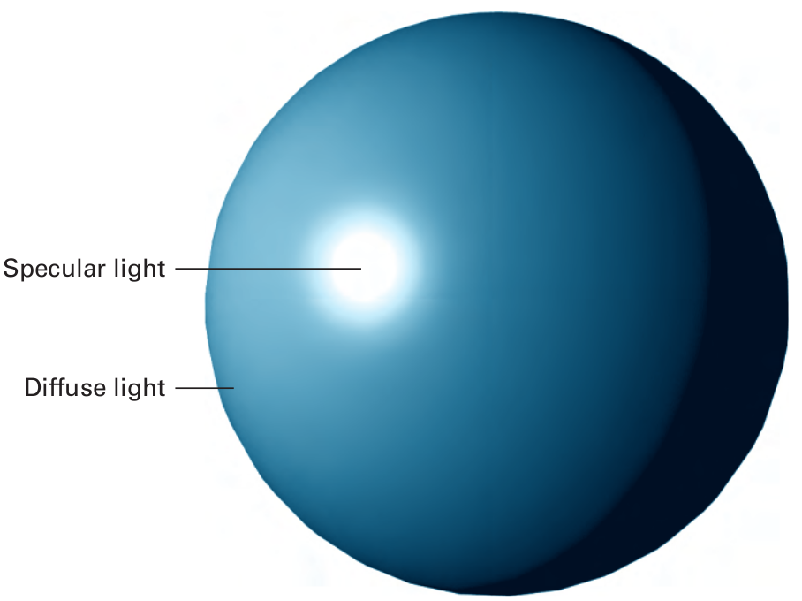
Figure 10.8 Specular versus diffuse light
0-<number>

Slide 14
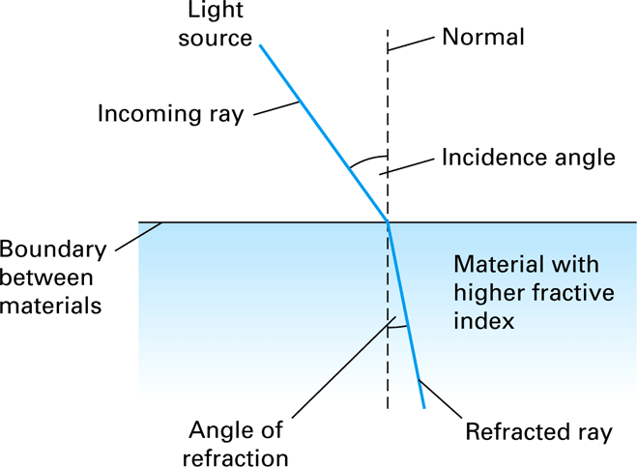
Figure 10.9 Refracted light
0-<number>

Slide 15
Rendering
Clipping: Restricts attention to objects within view volume
Scan Conversion: Associates pixel positions with points in scene
Shading: Determines appearance of points associated with pixels
0-<number>

Slide 16
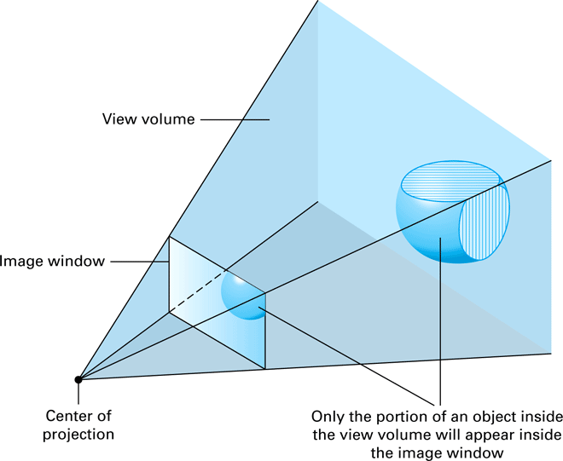
Figure 10.10 Identifying the region of the scene that lies inside the view volume
0-<number>

Slide 17
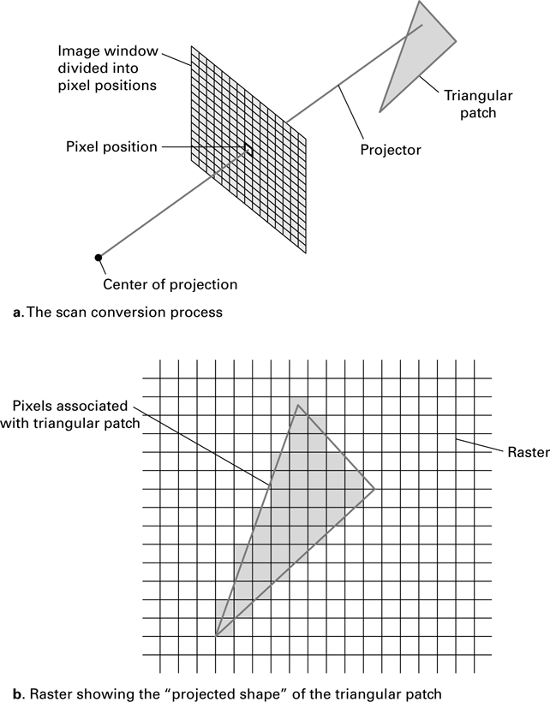
Figure 10.11 The scan conversion of a triangular patch
0-<number>

Slide 18
Shading Techniques
Flat Shading: Creates faceted appearance
Gouraud and Phong Shading: Creates smooth, rounded appearance
Bump Mapping: Creates bumpy, rounded appearance
0-<number>

Slide 19
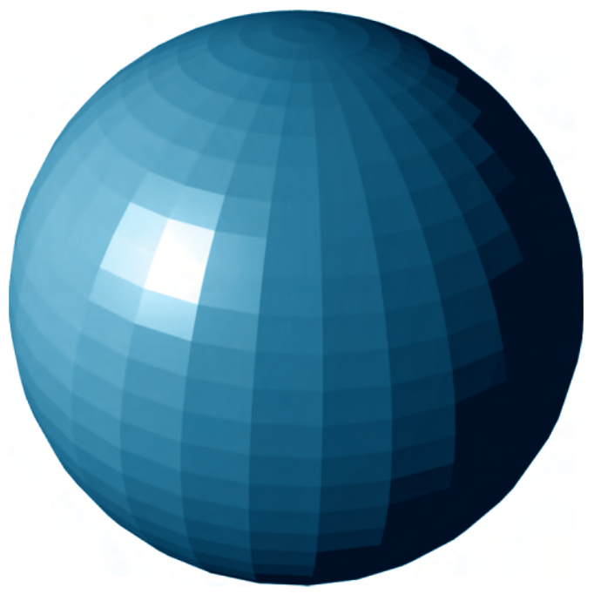
Figure 10.12 A sphere as it might appear when rendered by flat shading
0-<number>

Slide 20
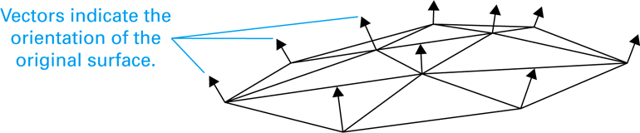
Figure 10.13 A conceptual view of a polygonal mesh with normal vectors at its vertices
0-<number>

Slide 21
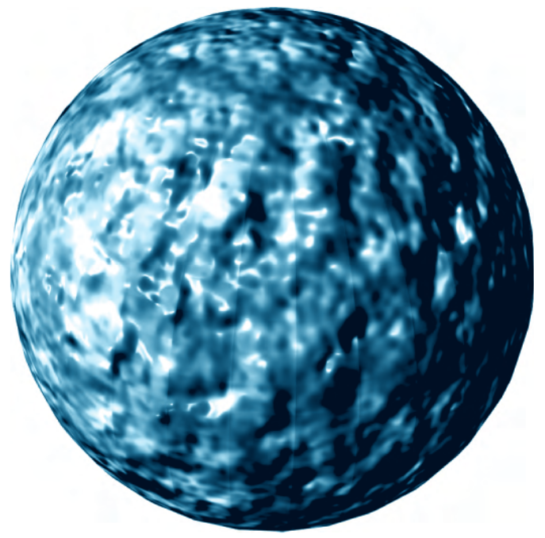
Figure 10.14 A sphere as it might appear when rendered using bump mapping
0-<number>

Slide 22
Rendering Pipeline
Consists of traditional algorithms for clipping, scan conversion, and shading
Often implemented in firmware
Used as an abstract tool in graphics applications
0-<number>

Slide 23
Local Versus Global Lighting
Local Lighting Model: Does not account for light interactions among objects
Global Lighting Model: Accounts for light interactions among objects
  Ray Tracing
  Radiosity
0-<number>

Slide 24
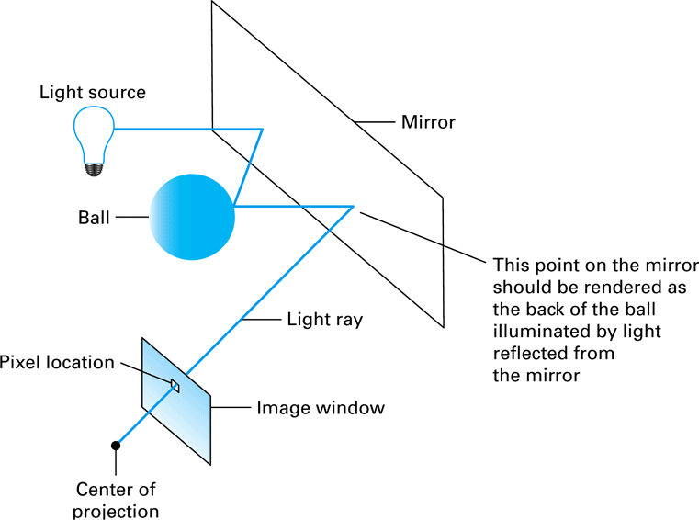
Figure 10.15 Ray tracing
0-<number>

Slide 25
Animation
Storyboard: A sequence of sketches summarizing the entire animation
Frame: One of many images used to create animation
Key Frames: Frames capturing the scene at specified points in time
In-betweening: Producing frames to fill the gaps between key frames
0-<number>

Slide 26
Simulating Motion
Dynamics: Applies laws of physics to determine position of objects
Kinematics: Applies characteristics of joints and appendages to determine position of objects
  Avars
  Motion Capture
0-<number>

